Slide 1
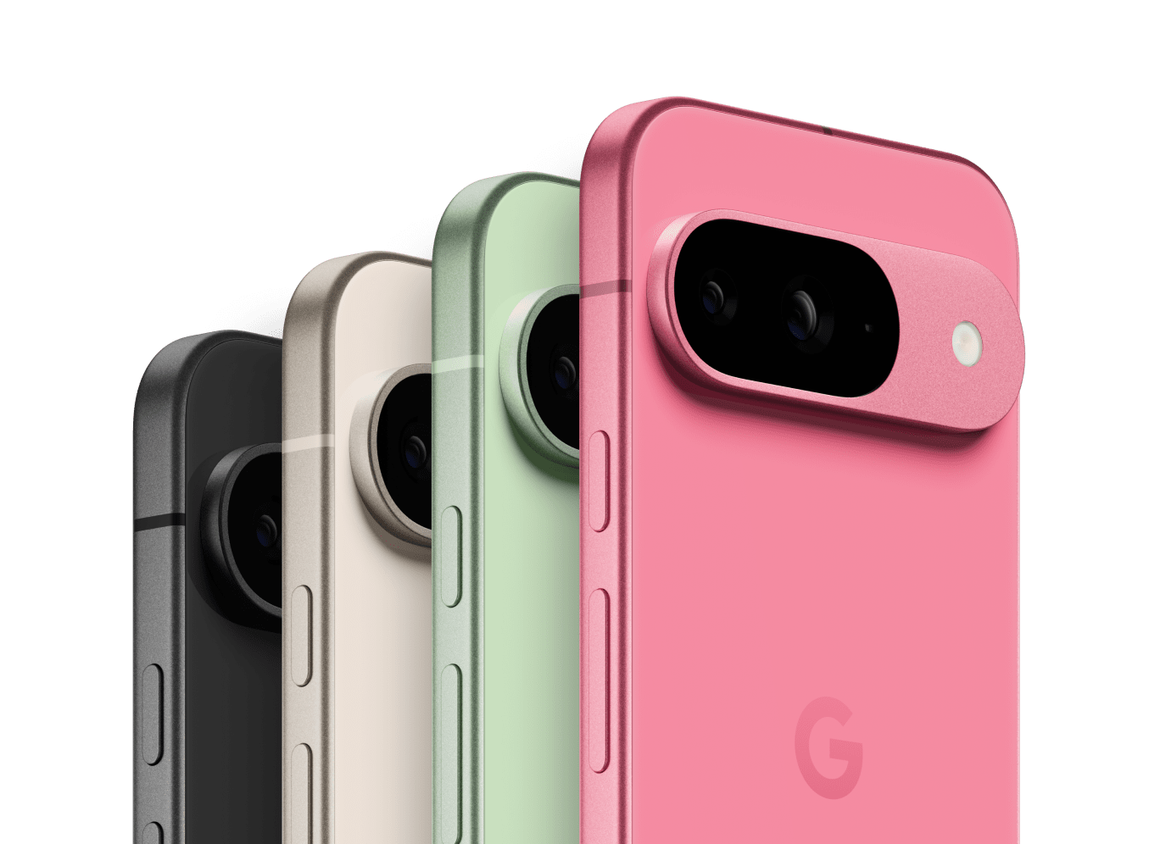
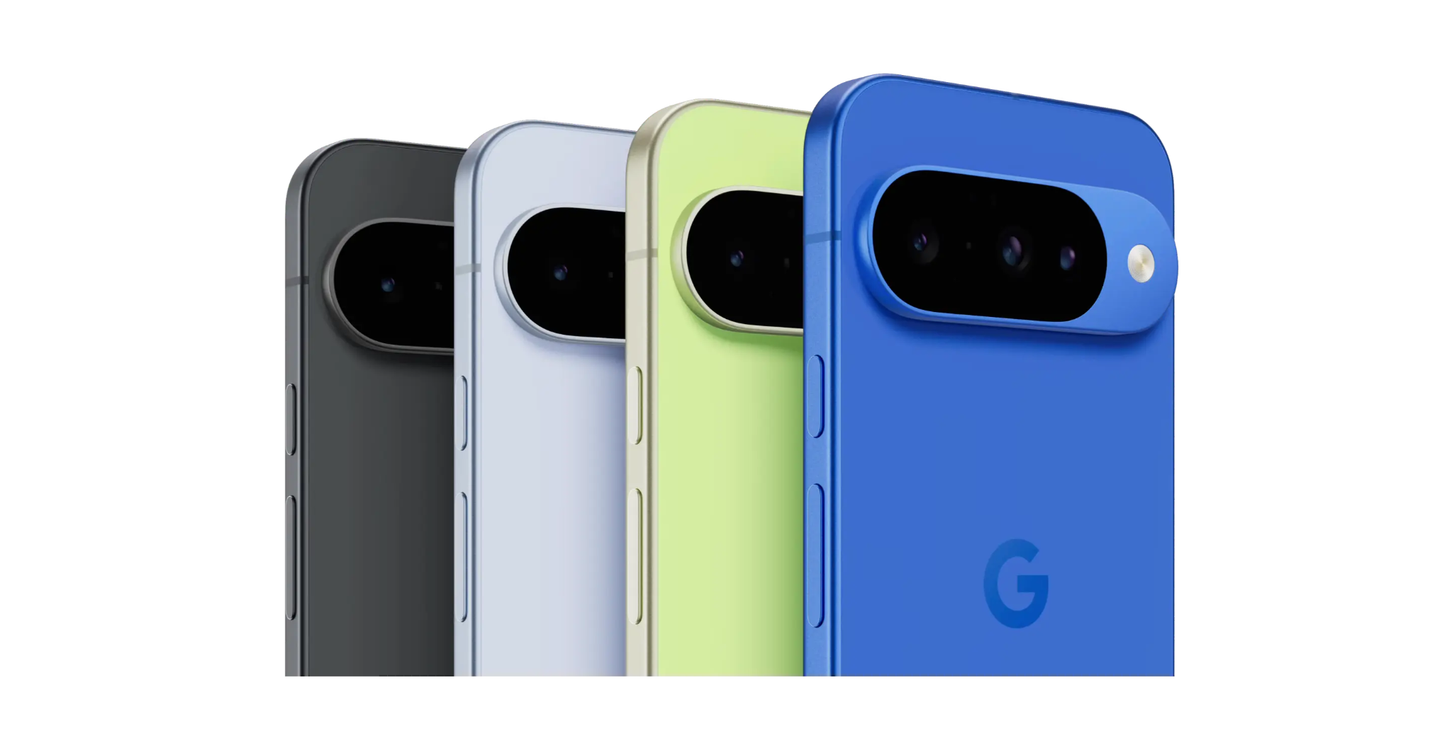
Google Pixel 10
Jayne Bogle, Lexi Jassin, Matt Koffman, Abby Pezce & Sarah Shenman
10/15/25
Group 6

Slide 2
Brand Positioning & Competitive Analysis
Brand Positioning:
Positioned as the smartest and most seamlessly integrated smartphone for everyday life
Differentiates through AI innovation - Gemini, real-time camera editing, personalized user experience
Eco-conscious and affordable
Strategy: highlight how Pixel 10 adapts to users’ unique needs through AI-powered convenience and smart integration
Competitive Analysis:
Google Pixel 10 leads overall with a score of 58, outperforming the iPhone 17 (57) and the Samsung Galaxy s25 (49)
Key Strengths: Built-in Gemini AI, superior camera editing tools, eco-friendly design, price point
Apple and Samsung lack in sustainability and AI integration, although Apple dominates in brand loyalty at a higher cost

Slide 3
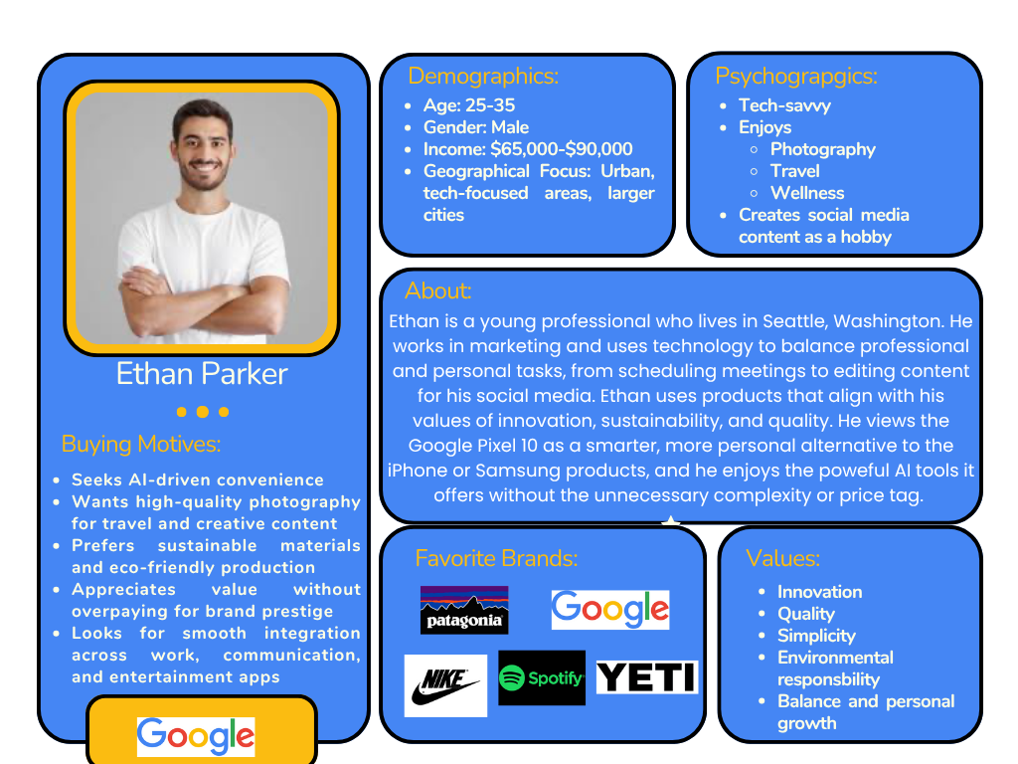
Persona

Slide 4
Promotional Strategies
Goal: Sell 500,00 phones over a six month campaign period
Innovation
Sustainability
XXX
XXX
10/15/25
Google Pixel
Notes:
Sarah
The promotional strategy for the Google Pixel 10 centers on blending innovation, simplicity, and sustainability to drive awareness, engagement, and sales over a six-month period. The campaign will position the Pixel 10 as the smartest, most seamlessly integrated smartphone for everyday life, designed with both advanced AI features and environmental consciousness in mind. Across consumer, trade, and experiential initiatives, each promotion shares a consistent message: Smarter. Simpler. More sustainable.

Slide 5
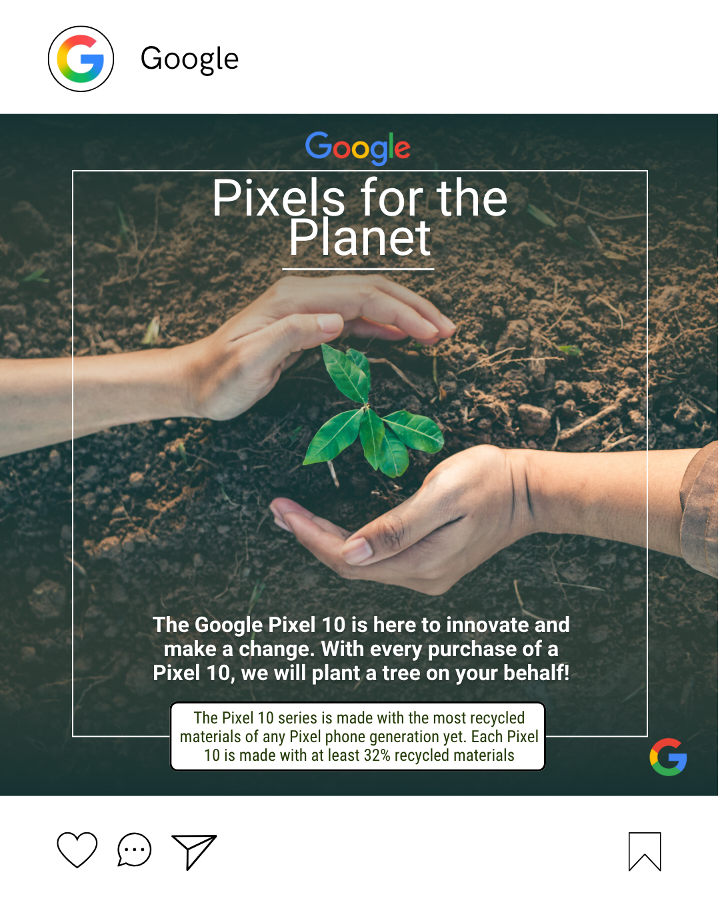
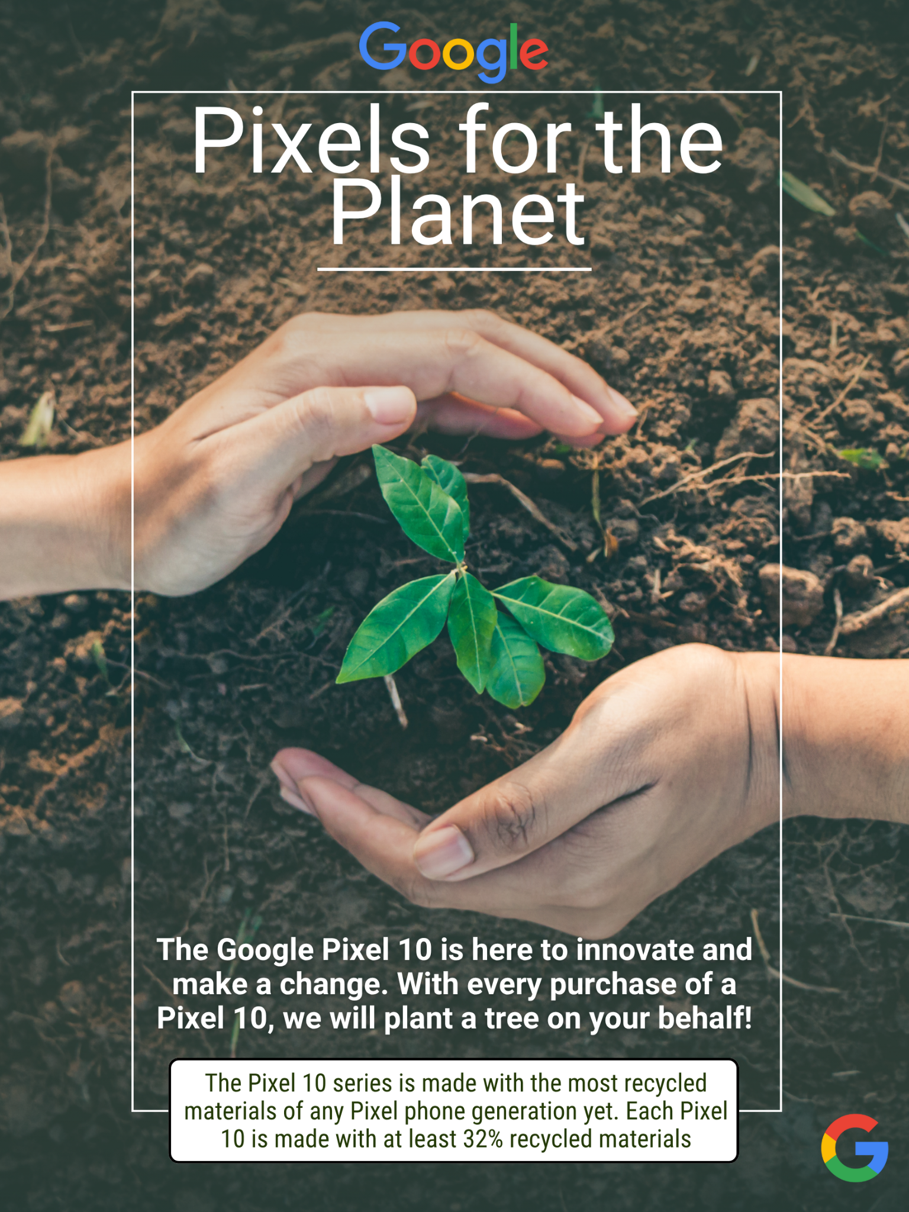
Consumer Promotion
Pixels for the Planet
Tactic:
Strategy: Position the Pixel 10 as an ethical and sustainable choice for consumers
Objectives:
Increase Sales
Strengthen Google’s Reputation
Differentiate from competitors
10/15/25
Google Pixel
Notes:
Sarah
Objectives:
Increase Pixel 10 sales by 15% among eco-conscious consumers during the 6-month campaign
Strengthen Google’s reputation as an innovative and sustainable tech brand
Differentiate Pixel 10 from Apple and Samsung products by highlighting its eco-friendly model made from recycled materials
Tactics:
Promotion: For every Pixel 10 purchased, Google plants a tree!
Messaging: “Pixels for the Planet”
Promote campaign through various channels both digitally and physically.
Physical fliers in store (Best Buy, Google, other retail partners) and through mail
Social media (Instagram)
Email and web banner
This initiative makes consumers feel like they are making a positive impact and a sustainable choice when purchasing the Google Pixel
This also reinforces Google’s commitment to sustainability with the Good Pixel product
Emotional appeal: Connects a purchase with a purpose.
Brand alignment: Google already invests in sustainability; this makes it consumer-facing.
Purchase motivation: Buyers feel they’re making a smart and ethical choice.

Slide 6
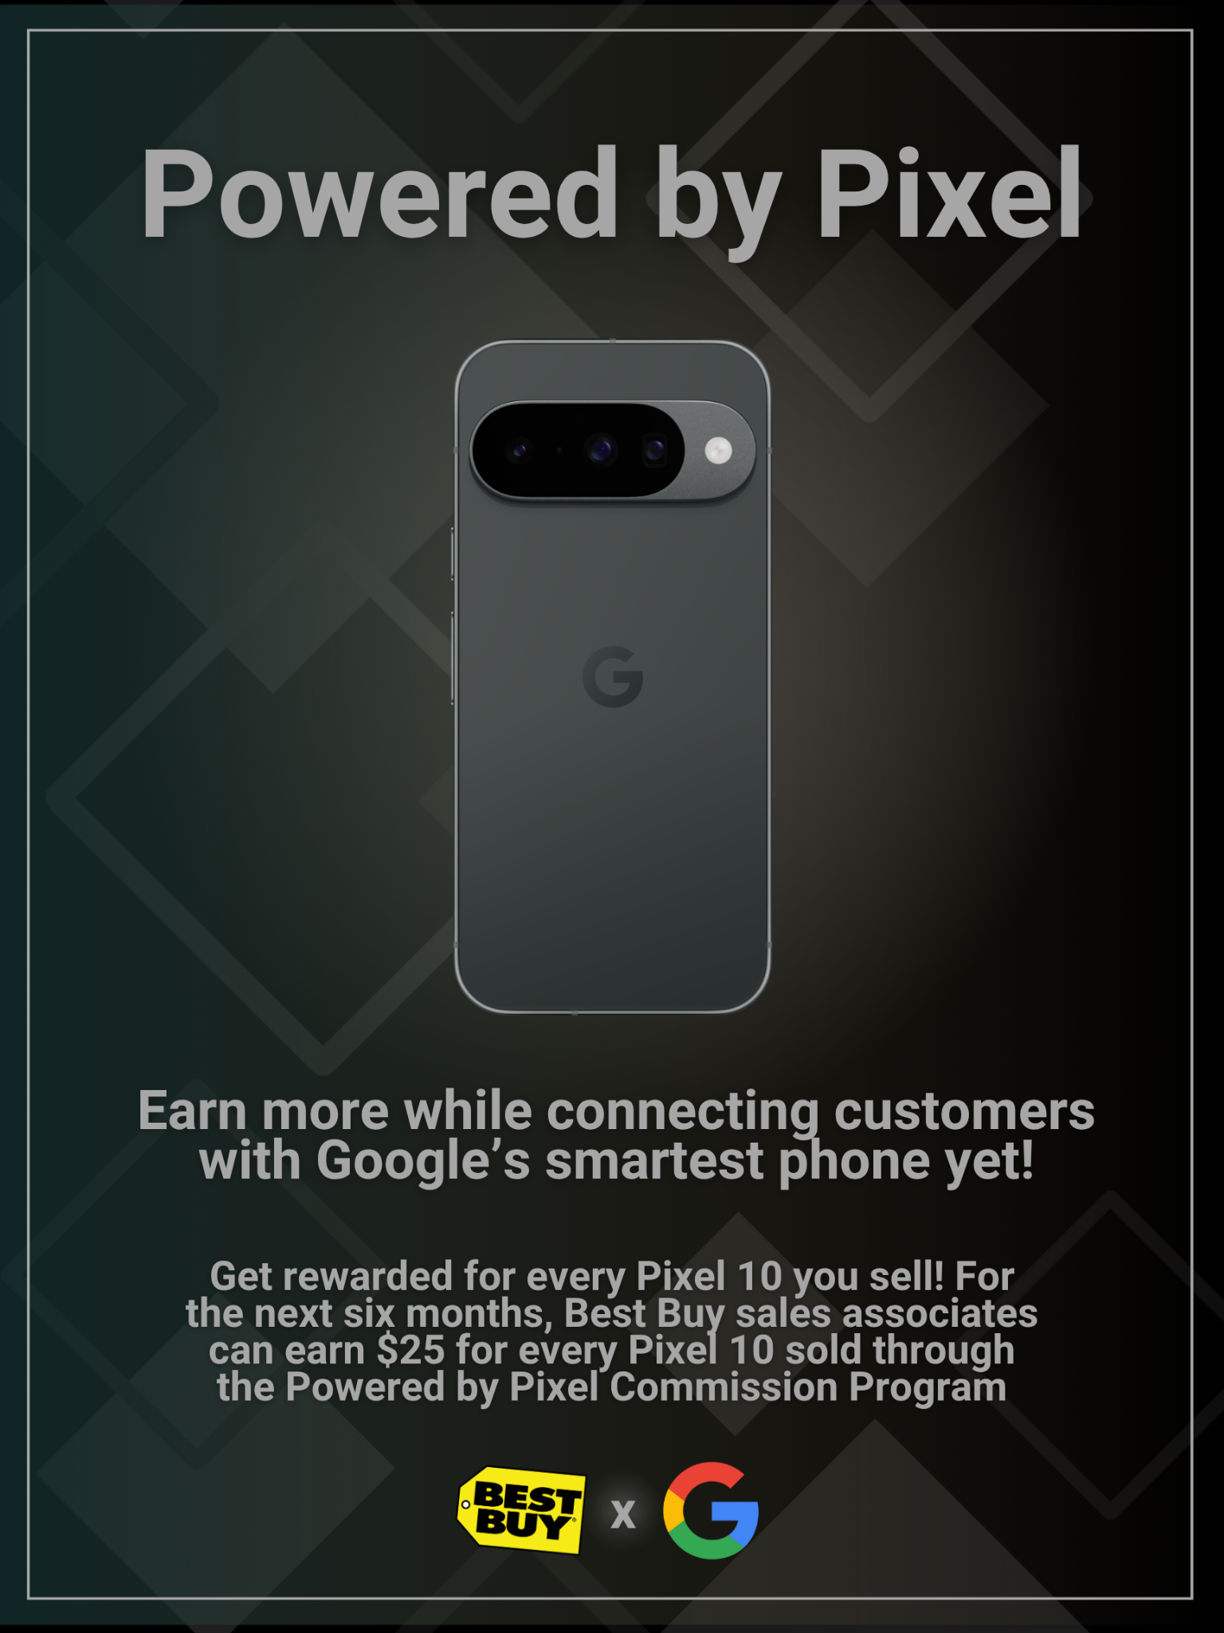
Trade Promotion
Tactic:
Powered by Pixel
Strategy: Drive sales motivation among Best Buy retail employees and staff
Objectives:
Increase Sales at Best Buy
Strengthen relationship with Best Buy
Improve in store advocacy
10/15/25
Google Pixel
Notes:
Sarah
Objectives:
Increase Pixel 10 sales at Best Buy by 20% during the 6-month campaign period
Strengthen relationships and brand collaboration with Best Buy
Improve in store advocacy and product knowledge of Best Buy sales associates
Tactics:
Commission Program: Sales associates earn $25 per Pixel 10 sold
Training Program: Provide training sessions for staff on the product and it’s features
Internal Communication: Use Best Buy’s internal communication platform (ie. newsletter) to announce the campaign
Motivates store employees to actively sell Pixel 10 over competitors.
Encourages knowledge and advocacy, as trained reps can confidently promote unique features.
Drives collaboration with Best Buy through financial and experiential rewards.

Slide 7
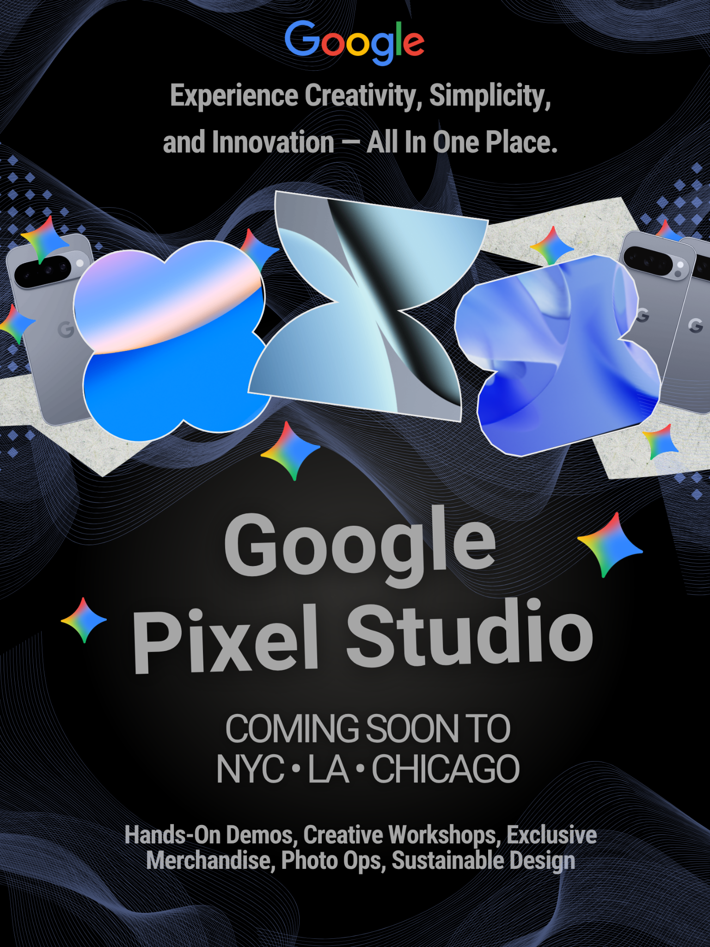
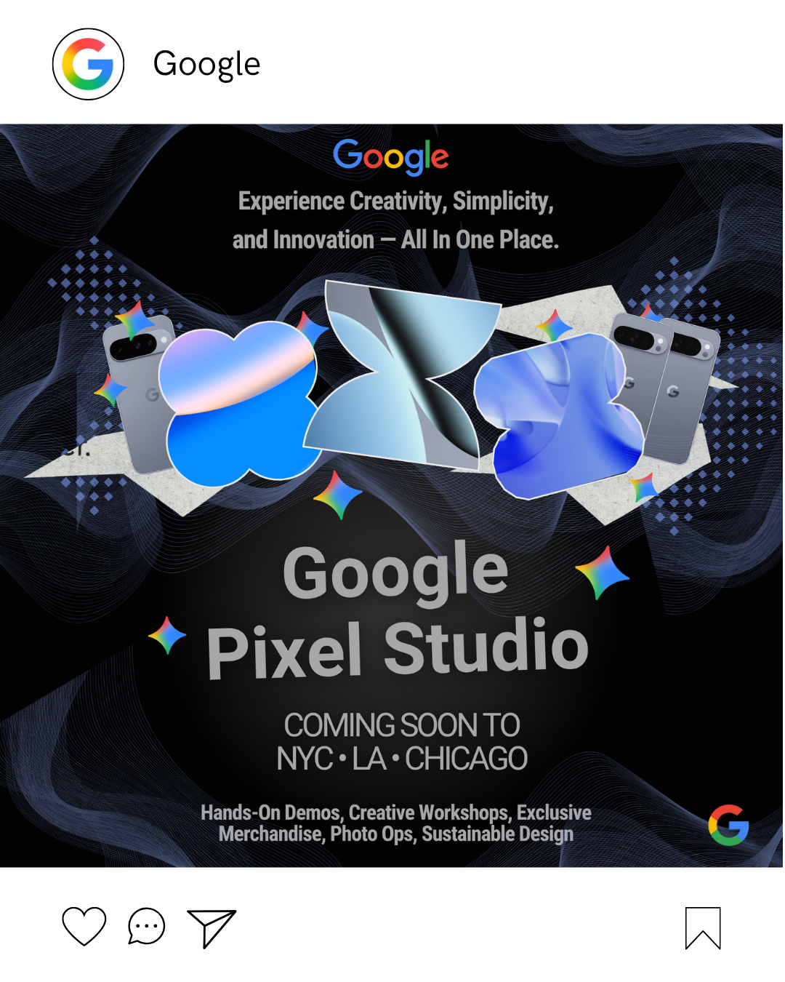
Alternative Brand Activation
Google Pixel Studio
Tactic:
Strategy: Create a memorable, interactive brand experience that increases awareness, engagement, and purchase intent
Objectives:
Generate social media impressions
Drive hands on interaction
Increase brand “buzz” and earned media impressions
10/15/25
Google Pixel
Notes:
Sarah
Objectives:
Generate __ social impressions and __ in person visits across pop-ups in 3 major cities
Drive hands-on interaction with Pixel 10 features, particularly AI camera and editing tools
Increase brand buzz and earned media coverage
Tactics:
Pop-Up: “Google Pixel Studio”
Immersive space in cities like NYC, LA, Chicago
On-Site Activities
Live product demos and workshops
Especially AI powered camera and editing tools
Exclusive merchandise and apparel
On-site purchases
Photo opportunities
Influencers
Invite tech, lifestyle, and sustainability creators to enjoy and share the experience
Hands-on engagement: Converts curiosity into conviction.
Social amplification: Encourages organic sharing and earned media.
Brand consistency: Communicates Google’s design ethos — modern, human, and responsible.

Slide 8
Dollar Sales & Total Gross Profit
Sales Goal & Distribution
Target min of 500,000 units
40% (200,000) through Best Buy
60% (300,000) through direct to consumer sales
Pricing Strategy
Direct to consumer ASP: $750, including a $25 promotional discount
Best Buy ASP: $600 ASP
COGS
$400 per unit for both channels
Gross profit
Profit = (ASP - COGS)
Profit = $145 million
10/15/25
Google Pixel

Slide 9
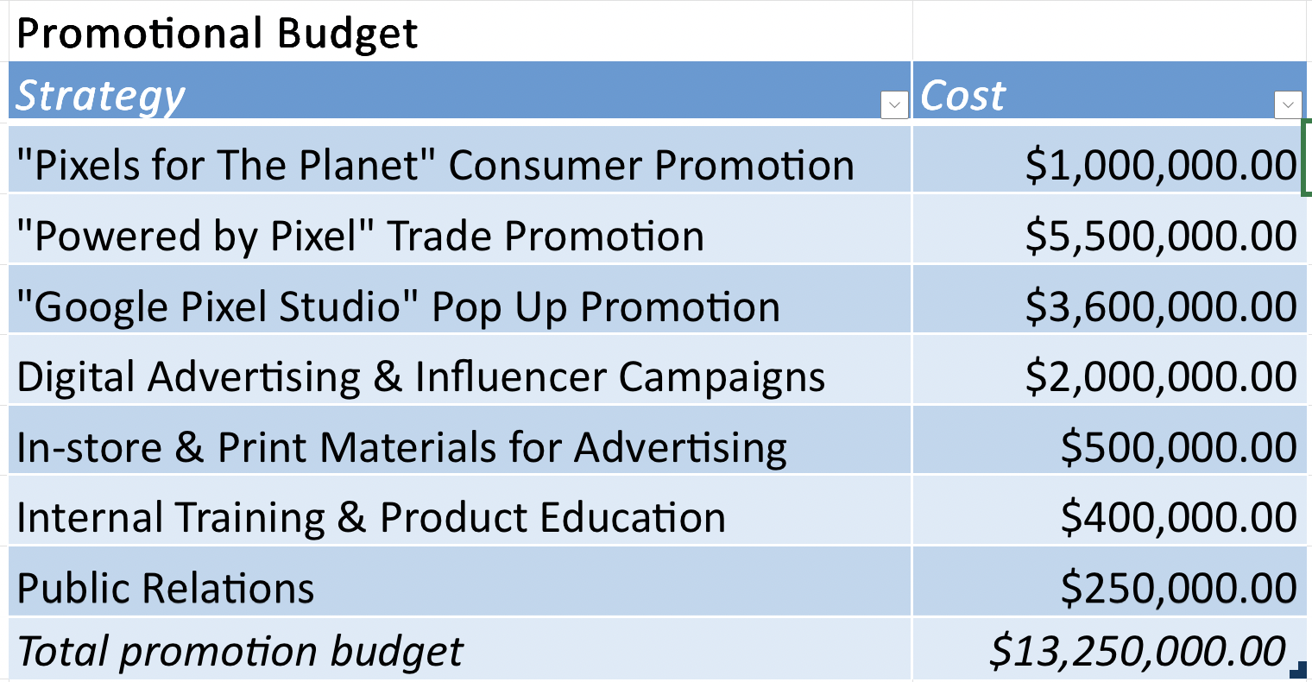
Itemized Budget Summary
Date
School Name
Notes:
Lexi

Slide 10
IBEV and ROI Overview
IBEV
ROI
45,689.66
994.34%
In order to reach a break even point given the promotional budget of $13,250,000 we would need to sell an additional 45,690 units.
For every one dollar that is invested in the promotional budget, we generate approximately $9.94 in net profit.
Incremental break even unit volume and return on interest are both important financial indicators for the promotional and sales strategies of the Google Pixel.
10/15/25
Google Pixel

Slide 11
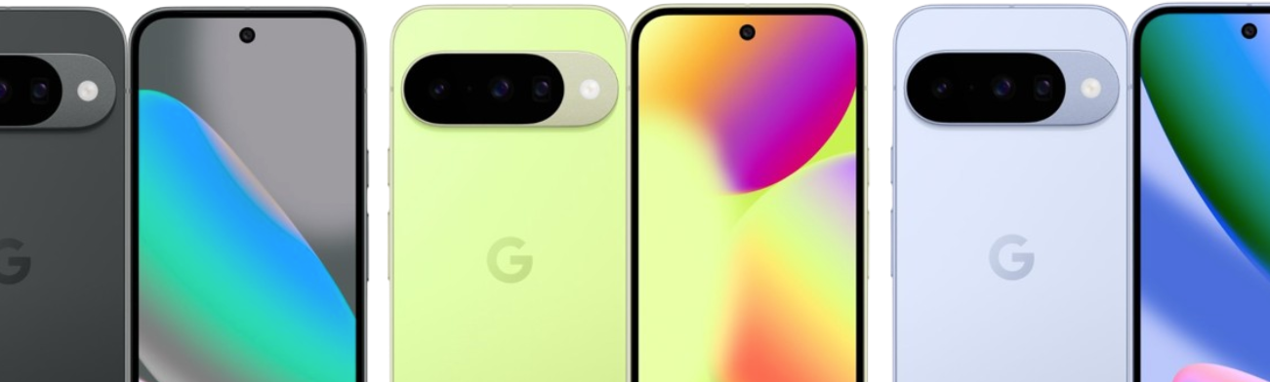
THANK YOU!
ANY QUESTIONS?

